Slide 1


People Power Safety
STEP Refresher Training
Instructor:
Notes:
Welcome!
Do introductions- I would like you all to introduce yourself, tell us how long you’ve been working, and your favorite: (pie/vacation/meal/hobby/vacation…use something personal – not sports).
One break in the middle
Safety moment…
We are very serious about this STEP Process from XXXXXX on down. We all will be held accountable for the information from these sessions.
Tell a story about a safety incident that affected you. What did you do? What challenges were there and how did you deal with it?

Slide 2

Quality
Production
Safety
Notes:
Sometimes our work seems to be fragmented…we focus on schedule…until there is rework, then it’s quality…which then puts us behind schedule and we drive work….then safety is at-risk. Is that how it should be? What do you leaders/companies focus on? How important are these metrics to you organizations…what gets the most attention? When does that attention shift? If some gets seriously hurt or dies, all the other silos are irrelevant. We need to break down our silos are look at our projects more as interrelated systems. We need a STEP change in thinking…we have been doing well, but people are still getting hurt….we are not finished yet.

Slide 3
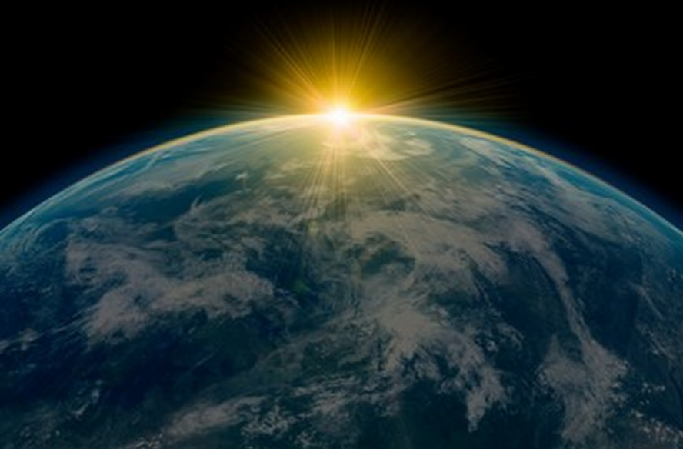
Notes:
We make a living by what we get, but we make a life by what we give.
Far and away the best prize that life has to offer is the chance to work hard at work worth doing.

Slide 4

Agenda:
STEP Purpose
Engagement
STEP Process
Participation
Data Use Plan
Quality
Notes:
REVIEW SLIDE:

Slide 5
STEP Purpose
We will achieve… Safety Through Everyone's Participation.
We will do this through actively engaging all employees to look out for the health and safety of each other.
We will identify and prevent situations that could result in serious injury or the loss of a life.
This information will be communicated on a regular bases with solutions and fixes.
We will strive to have better safety conversations
Notes:
REVIEW SLIDE

Slide 6
STEP Vision
To create a dependable, repeatable method to measure safety successes using leading indicators instead of Recordable Injury Rate and Lost-Time Injuries.

Slide 7
How do we Think about Safety?
We need to shift our thinking:
Safety is:
#1 Priority or Core Value?
Can Change Instantly
Changes Over Time

Slide 8
How is
Safety Motivated?
Internal or External?
(Responsibility)
(Accountability)
Notes:
BOTH…

Slide 9
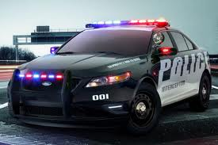

Accountability:
After the fact
Lagging
Consequences
Only when someone is watching!
Notes:
Think of it this way…I am responsible for my driving behavior. A policeman has the authority to uphold the LAW. However, both of us are ACCOUNTABLE for our duties, me obeying the speed limit and the officers for upholding it.

Slide 10
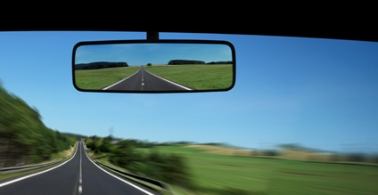
Definitions
Lagging Indicators
Measuring an organization’s safety performance based on historical loss information
Examples:
OSHA Recordable Incidence Rates
Lost Workday Case Rates
First Aid cases
Near Misses
Notes:
We are trying to move away from the lagging indicators. We never see the lagging coming, they are oh so clear in the rear view mirror.
We only have all the answers because we can see the outcome.
Try not to jump to conclusions. Try to put yourself if the situation to understand.

Slide 11
Responsibility:
Before
Leading
Ownership
What you do… when no one is watching!

Slide 12
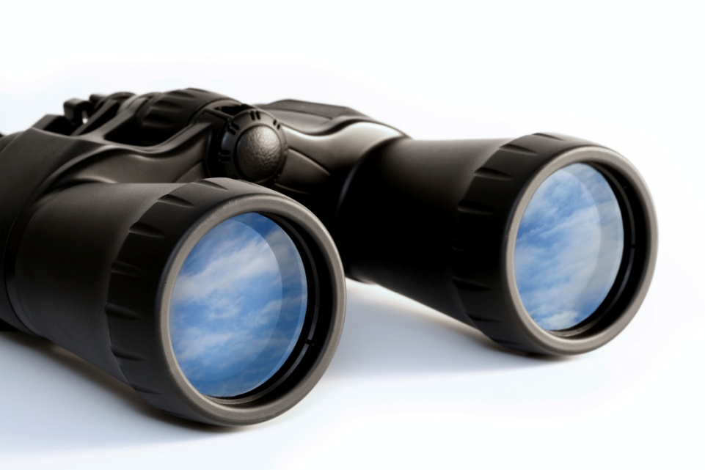
Definitions
Leading Indicators
Measurable factors of performance that may indicate a particular direction or trend
Examples:
Job Hazard Analyses / Job Safety Analyses
Observations
Employee Perception/Safety Culture Survey
Training Completion and Effectiveness
Notes:
We need full focus and engagement in these processes.

Slide 13
We Want People to
Work Safely
Even When
No One is Watching!
Notes:
I am not speeding because I see the highway patrol over there. Vs. I am not speeding because I know it’s the right thing to do. Because I know those signs are posted for my safety.

Slide 14
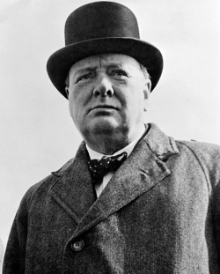
Character is what we do
when no one is watching
– Churchill

Slide 15

Where do we start?
Make it Personal
Safety
Step-Change
Trust
Active Caring
Notes:
Understand we are intruding on someone's space/ work area. Try to make things personal, but be mindful of your approach. Talk and approach people how you want to be approached.

Slide 16
We will create a positive
change in our
Safety Culture by…
Making Safety Personal
…because
People Power Safety

Slide 17

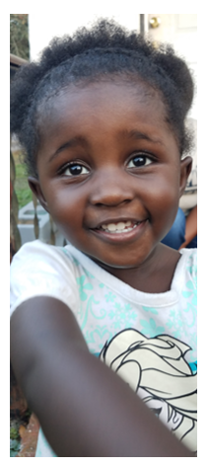

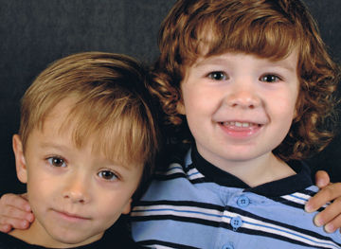
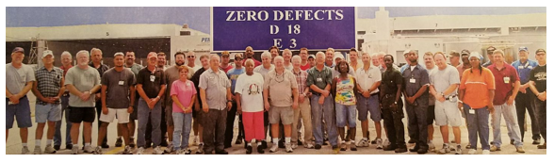
Why Should I work Safely?
Who Would Care
If I Was Injured?
Notes:
What is the worst thing that can happen if I take this risk? Who will I not see again if I take this risk?
No one goes into work thinking they are going to get hurt today.

Slide 18
Active Caring
Make it Personal
Safety
Step-Change
Active Caring

Slide 19
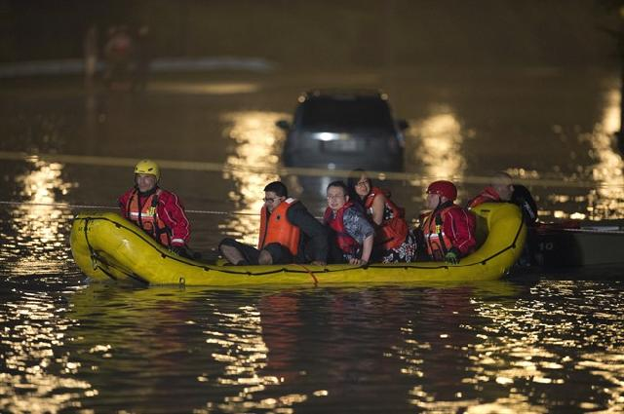

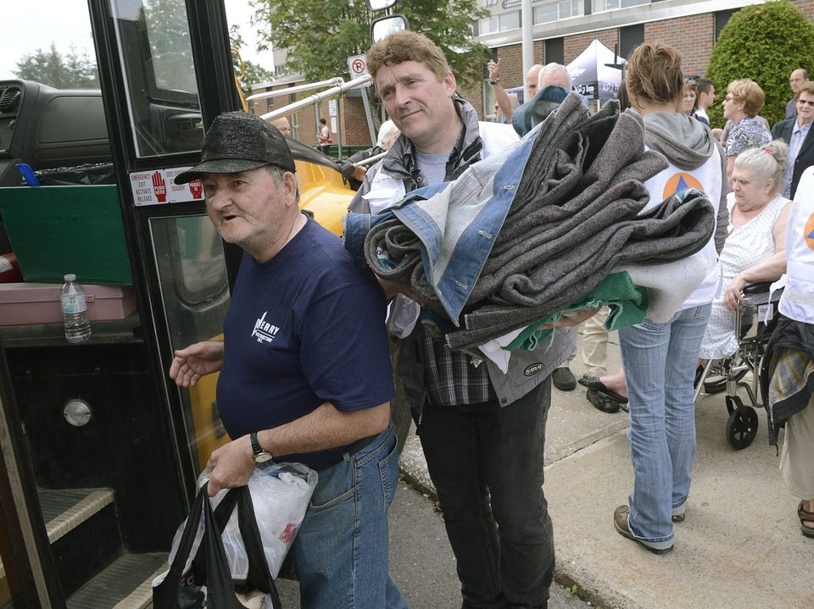
Active Caring
Moving beyond simply caring to acting on that caring

Slide 20
Completing the Triangle
Make it Personal
Safety
Step-Change
Trust
Active Caring

Slide 21
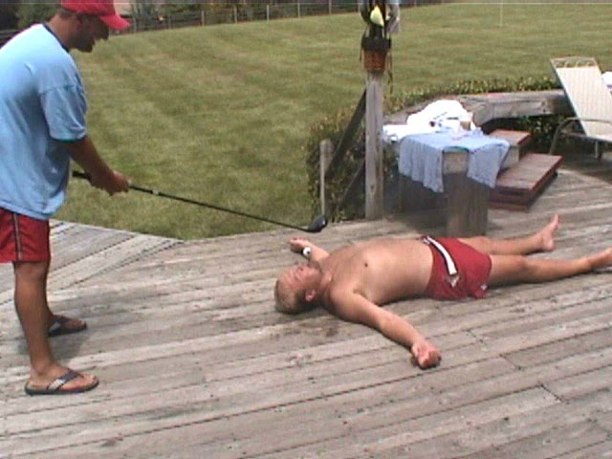
Notes:
High level of jubilance at the end. Flip that response had something gone wrong. Hit him in the temple/ jaw…

Slide 22
What’s Important for Safety Culture?
Trust
Firm reliance on the integrity, ability, or character of a person or thing.
Trust in Management:
Intentions
Behaviors
Trust in Coworker:
Intentions
Behaviors

Slide 23
Agenda:
STEP Purpose
Engagement
STEP Process
Participation
Data Use Plan
Quality
Notes:
REVIEW SLIDE:

Slide 24
Creating Employee Engagement
Involvement vs. Engagement
!!!
Notes:
Many are involved but to get people engaged must create a value proposition. The Chicken is just involved with breakfast but the pig is totally engaged.

Slide 25
Why are Safe Behaviors Hard to Motivate?
Consequences of Safe behaviors:
Less Comfort
Less Convenience
More Time Consuming
Consequences of At-Risk behaviors:
More Comfort
More Convenience
Less Time Consuming
Notes:
Easier to just do what you need to do – I’m just going to get in and get it done. Ex: Not wearing fall protection.
Everyone realizes the potential severe consequences of risky behavior. So everyone is doing 100% safe behaviors? They why are safe behaviors so hard to motivate? Well to start with, we are internally wired to find the quickest, easiest and most comfortable way of doing things. So how does that relate to safety?
Let’s take a look at the consequences of Safe Behaviors. Most of the time safe behaviors are less comfortable, less convenient and take more time to do. For example, why doesn’t everyone always wear safety glasses? They don’t fit and hurt my ears, they fall off when I work, they are in my truck…besides, I am only doing a 1 minute job here.
Now let’s take a look at the consequences of At-Risk Behavior. Most of the time risky behavior is more comfortable, quicker, and takes less time. What are the consequences for people not wearing their Hard Hat? It’s more comfortable, it’s more convenient when doing this task because it keeps getting it the way or keeps falling off, or it would take me more time to go back to the truck than just do this quick job and then move on to the next trouble call.
To even make it more difficult to motivate, the consequences of risky behaviors are typically very powerful; Certain, Soon, and Significant.
Another aspect that makes safe behavior hard to motivate is that risky behavior seldom results in a negative consequence. It’s good that injuries are rare, but this may give us a false sense security. Have you ever heard the phrase “That’s how we’ve always done it!” So experience tells me that if I speed in my car, it is possible I can get a ticket…not probable, though. And even less probable that I am going to get into a car crash!
So, we “weigh” the riskiness of situation. Now ask the participants this question: “How many of you conceder yourself a safety leader?”…then ask them this: “OK then, how many of you have ever stood on a chair to change a light bulb!?”…now you can give them the following example: “Here is an example of how we might use the scales (pictured on the slide) ‘weigh’ the riskiness of a situation…It is a few minutes before the big game and you just notice that you need to change the light bulb in the ceiling before your friends come over.” Now the scales come out… “You have the new light bulb and you think to yourself, I could go out to the garage and get the ladder, or I could stand on this chair to reach it”. “It would take more time to go out to the garage to get the ladder and more inconvenient.” “Now It’s a whole lot quicker to stand on the chair and the chair is right here (more convenient)”. So, what do we do? We jump up on the chair! Again, look at the certain, Soon & Significant aspects of this example!
So, we might not “consciously” weigh those out in our mind…it may only take a fraction of a second…but that’s how many safety decisions are made and how consequences play a role in those decisions.

Slide 26
What Motivates a Better Safety Culture?
Culture
Environment
Leadership
Behaviors
Core
Values
Notes:
It is virtually impossible to measure “culture”.
When people move form one organization to another, or when people visit different countries, people know there is a difference in culture, but it’s something that is difficult to put your finger on. So, how do we impact something that is not measurable? Well, how do we adapt to a new job or culture? When in a socially “ambiguous” situation, we first examine the environment. We try to match our past history with what we are currently seeing and merge the two together. In organizations, this “new” culture directly impacted by the leadership team; what they say, what they do, and how consistently they hold people accountable. So new employees may listen to what the leadership team says, but they will then observer their behaviors; they will see if management “walks-the-talk”. Most of the time, these observable behaviors are motivated by our internal core values. Very seldom do we ever go against our core values…they are our guiding principles and thus are strong motivators of our behaviors.
So to change a culture, organizations first need to revisit their Core Values and assess if the corresponding behaviors are being accomplished in a consistent manner. When leadership is seen as engaged in safety because they feel “it’s the right thing to do”, as opposed to “the thing I have to do”, then the Leadership of the organization can influence the environment and eventually the culture will follow.
Final questions: Which way do we influence Culture? (red arrows) From the Values out to the Culture, or from the Culture in to the values? Both, really…If we have weak core safety values, this may produce a weak culture over time. If the organization gets different leadership or goes through some external strife (e.g., merge, budget, economy), if our culture is so strong this will keep our core values in place.

Slide 27
After STEP: We are Hurting Less People
OSHA Recordable Rate for Construction Average = 3.8
Notes:
Following STEP, we hurt fewer people. We were gathering over 900% more information than before, having conversations with our contractors, and identifying areas for improvement.

Slide 28
But our Serious Injuries haven’t improved!
SIIR Defined: (Krause & Murray, 2014)
Life-Threatening Injury:
Significant loss of blood
Trauma to vital organs
Damage to brain or spinal column
Life-Altering Injury:
- Permanent or long-term impairment of loss of internal organ, body function, or body part
SIIR = Serious Injury/Fatality Incident Rate

Slide 29
Our Serious Injury/Fatality Incidence Rate is Gradually Increasing (SIIR)
Notes:
SIIR Rate is slowly increasing

Slide 30
Bottom Line: People are Still Getting Hurt
…we are not finished yet!
“WORLD CLASS”
“Best in Class”
Safety Improvement
Better
Good
Good
Great
We need a “STEP-Change” in our Safety Culture
Notes:
The STEP initiative is not a typical safety program that has a beginning and an ending (like safety bingo or an incentives). STEP was created by a team of operations, safety and leadership. To avoid the common safety “program” issue of “flavor of the month”, the STEP “process” was originally designed to evolve over time before the current version begins to become stagnate. So, we are not done yet…the next version of STEP has begun!

Slide 31
Agenda:
STEP Purpose
Engagement
STEP Process
Participation
Data Use Plan
Quality
Notes:
REVIEW SLIDE:

Slide 32
STEP – Process Overview
STEP is an observation and feedback process. It’s all about the conversation!
Work is observed…
…feedback is then given on risky and safe behaviors, conditions & processes.
Data is collected using checklists or mobile devices.
The information is then analyzed, followed-up on, and communicated to everyone.
Notes:
More overview….Although this seems very data oriented, stress it’s about having more relevant conversations and trying to get ahead of incidents and injuries.
REVIEW SLIDE:

Slide 33
STEP – Process Overview
We are NOT trying to catch people doing something wrong…just have a conversation.
We are trying to understand why people are doing something risky and how conditions could impact safety.
Additionally, we are looking for things in the system that are allowing or encourage craft to do risky behaviors…and thus change/improve the system.
FACT Finding
Notes:
So our focus.
REVIEW SLIDE

Slide 34
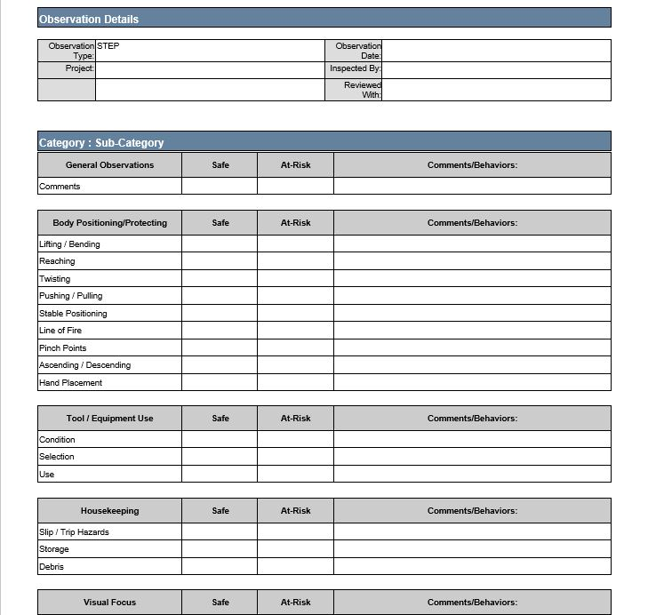
STEP Observation Checklist
Notes:
Review how to use the STEP checklist.

Slide 35
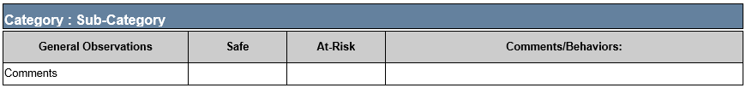
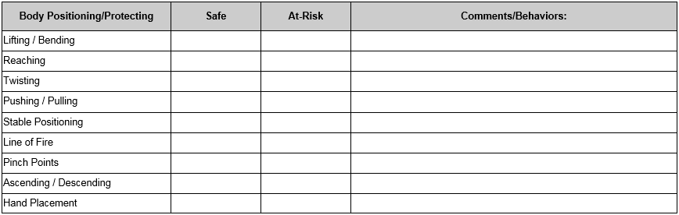
General Observations
The General Observations section is used to enter any behavior, condition, or process not covered by the STEP observation checklist.
Notes:
Review how to use the STEP checklist.

Slide 36
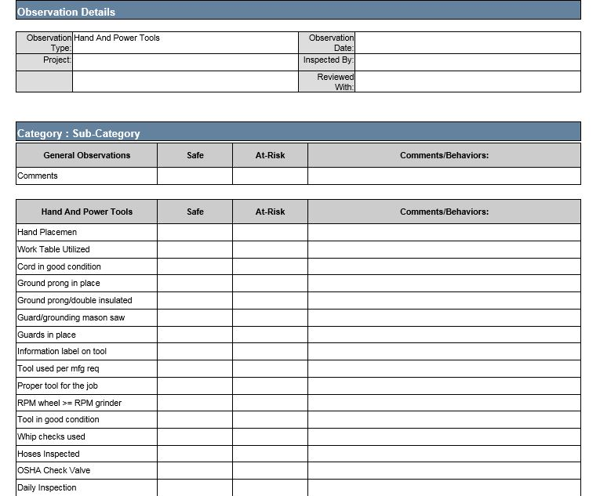
Focused Observation Checklist
Notes:
Review how to use the STEP checklist.

Slide 37
Feedback is a Key to Effective Leadership
People have an internal drive to feel competent.
Leaders’ behaviors (verbal & non-verbal) can impact craft future performance.
Feedback can be a consequence and a powerful motivator.
Both informal and formal recognition can motivate employees.
Help them feel competent by giving quality recognition.
Any recognition (negative & positive) you give send a strong message for future performance.
Quality recognition can help build a teamwork atmosphere.
Notes:
REVIEW SLIDE

Slide 38
We Need to Watch our Language
To change the way people think about safety, you have to talk differently about safety:
Achievement not failure oriented
Use At-Risk or Risky not Unsafe or Wrong: “That looks risky to me, help me understand why you…” or “I think you’re putting yourself at-risk for an injury” vs. “That’s unsafe. What the “~*#@%” are you thinking?!” or “That’s wrong you “%$*&”, let me show you the right way!”
Good!
Not So
Good!
Notes:
Think about how we approach and coach as we have conversations.

Slide 39
Choose Your Word Carefully
We want to create a “safety conversation,” not a one-way top-down communication!
When talking safety, stay away from words like:
Bad: “That’s really bad, what are you thinking?”
Improper: “That’s the improper way of holding that wrench”
Wrong: “What’s wrong with you, that’s not how we do it?”
Inappropriate: “Those clothes are inappropriate for the job”
Or use “rules” as a easy out: “You know it’s against the rules, you’re gonna get us all fired?”
Notes:
REVIEW SLIDE

Slide 40
When Giving Rewarding Feedback…
Try to make it personal: “I appreciate how safely the team is getting things done”
Never just say “good job”…use a behavior: “Hey, good job using a team lift…”
Try to build their “confidence” or “competence”: “You guys are a bunch of professionals…most of the time!”
Use humor sparingly or in a non-degrading way: “Hey, you’re no Marino…don’t toss wrenches!”
Give feedback one-on-one, or in front of a group if the person is okay with that.
Notes:
REVIEW SLIDE
Something people don’t often think about is strategies for giving rewarding feedback….especially the last one.
Most people have heard the phrase “praise in public and reprimand in private”. That is only partially correct…never praise someone in public unless you have their permission first. Some people rather stay in the background and be informal leaders. Or, if you single people out in a crowd, this might be embarrassing and they could hear about it from their friends at a later time (e.g., sucking up comments).

Slide 41
What is Your Level of Listening?
Non- listener
Marginal
Listener
Evaluative
Listener
Active
Listener
Empathic
Listener
Notes:
Once skill that take a great deal of skill is listening. Listening and getting into a conversation are keys to helping make the STEP process a success.
Non-Listener: You are blatantly not listening…this may be a skill we need when we have multiple conversations going on around us. To be a good listener, in some instances, we may need to be a non-listener.
Marginal Listener: this level is where are maybe multitasking and trying to listen at the same time. In today's work world, with many conference calls, one might be tempted to multitask while on a conference call (show of hands….how many of you ?)
Evaluative Listener: Have you ever caught yourself wanting to finish someone’s sentence…or thinking about your rely even before the person has finished their sentence?
Active Listener: is a skill where you probably could repeat back exactly what was said and you seek clarification through paraphrasing and questions before you make a comment. This is the level we want to strive for.
Empathic Listener: Is the step above Active listening where you not only listen well and be an active part of the conversation, but you also look for cues from body language, word choice, word order and general affect of the person your speaking with. This is the level many clinicians and counselors hold conversations (Have you ever hear someone say…How does that make you feel??)

Slide 42
Improve Your Listening Skills
Pay Attention – focus on content, not delivery
Respond – seek clarification, question, paraphrase
Let speaker finish – don’t prepare what to say next
Main Ideas – facts, feelings, values, opinions
Eye Contact – focus on the speaker, not your watch
Notes:
Review and give personal examples…they work the best for this communication skills!

Slide 43
Pre-Observation Thoughts
Who…will your focus be on?
What…do you expect to see?
When…would be the best opportunity to observe?
Where…would my observation and communication make the biggest impact?
Notes:
Before you go out to do a safety observations, think about what you may observe, what have you seen in the past and what should be your focus for this observation. Sometimes it’s easy to focus on things we find interesting and this can take our minds off of what we need to be focusing on….be intentional in your observations!

Slide 44
Conducting Behavioral Observations
Focus on behaviors…what you see people doing.
Do NOT focus on rules/regulations or Policies.
Mark all behaviors you see Safe or At-Risk.
Record the severity of the risky behaviors.
Identify any Error Traps and record them
Record comments to clarify what you observed.
Give feedback on both safe & at-risk observations.
Notes:
Key methods for conducting a STEP behavioral observation. 100% safe is not the goal for observations—aka pencil whipping. The goal is also NOT to “write someone up and find fault.” Part of the value of the STEP observation is the discussion with the crew. Get their feedback. They can also bring up their own safety concerns.

Slide 45
Conducting Compliance Inspections
Proceed to the predetermined location.
Focus on conditions around you.
Mark all conditions on the checklist Safe or At-Risk.
Record the severity of the risky conditions.
Identify any Error Traps and record them
Record comments to clarify what you observed.
If employees are present, give feedback on both safe & at-risk.
Notes:
Again focus on the conversation

Slide 46
Define Severity - Exercise
Probability
Low
High
Low
Medium
High
Life Threat
Low
Severity
High
Notes:
Here is how we will define severity…with examples to follow.

Slide 47
Agenda:
STEP Purpose
Engagement
STEP Process
Participation
Data Use Plan
Quality
Notes:
REVIEW SLIDE:

Slide 48
STEP PARTICIPATION
Improve Safety Culture through STEP observations and safety conversations
Safety Teams conduct observations
Monitor observation quality
STEP data communication IAW Data Use Plan
Improve contractor engagement / awareness
Improve Leadership engagement conversations
Conduct Focused Observations based on the data
Reduce probability of serious injuries & fatalities
Notes:
Based on feedback from our employees, leaders, contractor partners, and the survey data, we focused on several changes.
REVIEW SLIDE:
Each item will be discussed in more detail in the slides to come.

Slide 49
STEP Process: Participation Expectations
Everyone will participate IAW management guidelines.
Participation can be individual, in pairs or in a group.
Each person will schedule their participation.
For instance:
Every Tuesday and Thursday
Two for Tuesday will be my “Paired Observation”
The team will schedule each day (AM / PM).
Based on the weekly look back/ahead, select a location, contractor, task, or floor as your target.
Complete the observation or inspection on paper or in the SafetyNet app immediately following the participation.
Notes:
REVIEW SLIDE
Here are the expectations

Slide 50
STEP PARTICIPATION
Who will do STEP Observations?
EVERYONE! All Southern Company staff included but not limited to: Plant Manager, Managers, Supervisors, Safety Committee, & Contractors
How many STEP observations are required?
Weekly, monthly, or quarterly observation rates will be determined by management. (Ex. Two observations per week)
Who do we observe?
Anyone in our work areas.
Do I have to give feedback?
YES! Feedback should be given to the person/s observed when appropriate. ANYONE HAS THE RIGHT TO STOP AT RISK BEHAVIOR!

Slide 51
Predictive-Based Observations
We are going to be more intentional with our safety observations.
Sometimes people walk around the workplace looking for things wrong.
Sometimes people do observations to check-off another item on their to-do list.
Much like a doctor, we need to read our project’s “vitals”, diagnose concerns, and then focus our observations.
Notes:
In STEP 2.0 we are going to be more intentional….just simply walkig the project looking for something wrong.
REVIEW SLIDE

Slide 52

Expectations: Weekly Staff / Safety Meetings
During Meetings:
The Week “Look-Back”
Review the incidents, near-misses, first-aides, and behaviors from the previous week
Review the previous weeks observational data
Review the open-items
The Week “Look-Ahead”
Identify potential safety “clashes”
Look for Serious Incident Precursors
Pin point any Error traps
Notes:
REVIEW SLIDE

Slide 53
Predictive-Based Safety
Once we have completed our Safety Diagnostics, we prescribe various types of observations.
Based on our data, we are attempting to predicting where a potential incident, injury, near-miss or error might occur.
Our tools to help our weekly focus are:
Serious Injury/Fatality Precursors
Error Traps
Project / Work Area considerations
Intuition
Notes:
REVIEW SLIDE

Slide 54
Serious Injury/Fatality Precursors (SIIR)
Confined space entry
Jobs that require clearance/lock-out tag-out
Excessive speed/distracted drivers
Working at height/elevations
Manual handling
Process instability or significant process upsets
Unexpected maintenance or changes
High potential energy jobs
Emergency shutdown procedures
Work under suspended loads
Machine guarding and barricades
Use of hot work permits, equipment and pipe opening of hazardous chemicals
Notes:
Based on our past injuries, these have been found to be possible precursors or things that may cause serious injuries. So the Team may review this list as they are going over the week look back/ahead to help identify a potential for an observation.

Slide 55
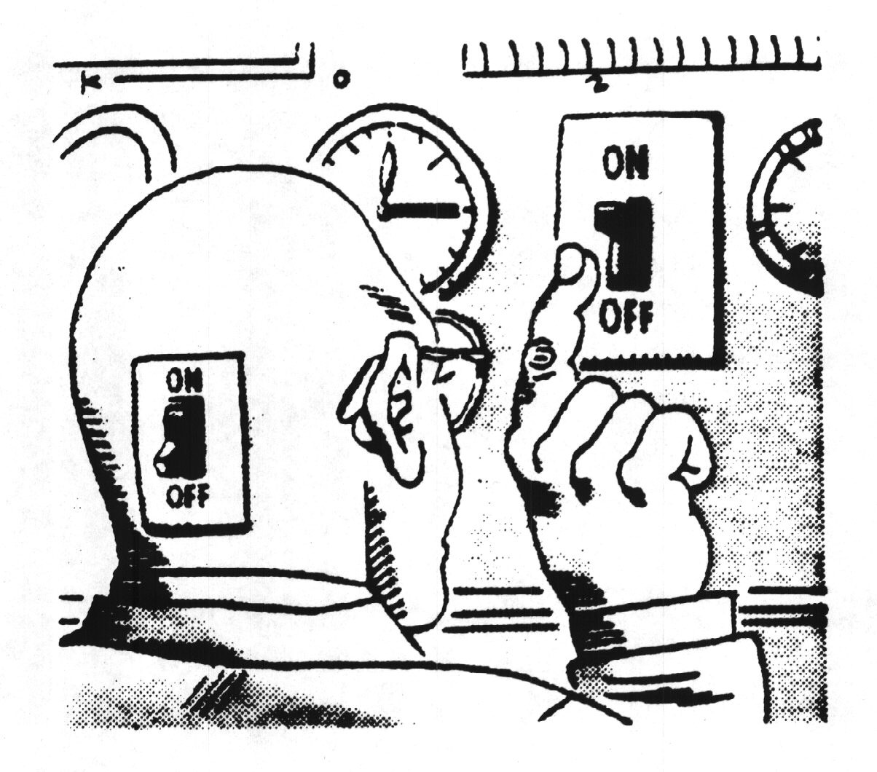
Error Traps: Error-Likely Situations
Overconfidence
Time pressure
High workload/Stress
Distractive environment
First time or infrequent task
First working day after a break
Imprecise communication
Vague or incorrect guidance
Half an hour after wake up or meal
Human Nature
Notes:
Another Diagnosis tool are Error Traps. Again during the project meeting review the above situations for potential observation targets.
Error Trap History in Southern Company.
Dr. Chong Chui, PhD from MIT
- Studied 87,000 events over the last 8 years in our industry and found that:
As error traps increase, probability of injury or event increases.
Human Error increases by a factor of 5 for every 5 degree increase in temperature.
71% of electrocutions in T&D occur on Fridays!
Human Error events peak between 1:30 and 2:30 in the afternoon.
AUDIENCE: Do these statistics surprise you? How are you feeling right now after lunch trying to digest this dialogue on HP theory?
These are a fact of life, not going away.
Ex. In meeting with Fluor – they acknowledged that 70% of their accidents in a specific location occurred in the hour after lunch

Slide 56
Agenda:
STEP Purpose
Engagement
STEP Process
Participation
Data Use Plan
Quality
Notes:
REVIEW SLIDE:

Slide 57
Example: Completing a Data Use Plan
What is a SafetyNet Data Use Plan?
A Data Use Plan answers the following:
Who will receive SafetyNet reports?
How often will they receive the reports?
How will it be communicated to all personnel?
How will we USE the information?
Notes:
REVIEW SLIDE

Slide 58
SafetyNet Data Use Plan
Type of Report | Frequency | Target Contacts | How Communicated? | Anticipated Report Value | Information Captured
Contractor Summary Report | Monthly |  | Program Coordination Meeting | to review contractor’s performance, recognize positive achievements, develop action plans for identified areas requiring improvement, ensure observations are commensurate with risk | Shows inspection information for each contractor affiliated with the project, including the number of inspections completed, safe and unsafe observations, percent safe and dates and times of last inspection
Detailed Report | Monthly |  | Communicated Internally Amongst Safety Leaders | Feedback to inspectors, improving trending, focus resources | Detailed inspection observation information, line by line, with comments.
Observer Summary Report | Weekly (Sun) |  | Semi-Monthly Daily Safety Field Meeting (Monday Morning) | Driving accountability (Who?), ensuring inspectors are meeting expectations, recognize positive achievements and develop action plans for identified areas requiring improvement. | Shows, by each individual user, the total number of inspections and observations within a given time period, as well as last synchronization and inspection date.
Open Issues Report | Daily |  | Program Coordination Meeting, Communicated Amongst Safety Leaders | Ensure open issues are being closed in a timely manner risk categorization. High risk closed faster than lower risk. | Shows a list of all uncorrected observations for the project. Can be used to track and follow up on items that are close to, or over their due date. (Don’t wait to communicate open issues at this meeting, they should be communicated immediately.)
Summary Report | Weekly (Sun) |  | Daily Safety Field Meeting (Monday Morning) | Provides opportunity to coordinate inspection activities based on cumulative weekly observations. Focus can be shifted as necessary. | Summarizes observation information for all leading indicators, sorted by safety category and/or sub-category.
Summary Report | Monthly |  | Semi-Monthly Manager Meeting | Facilitates the development of short term action plans and long term initiatives based on collected data.

Slide 59
Agenda:
STEP Purpose
Engagement
STEP Process
Participation
Data Use Plan
Quality
Notes:
REVIEW SLIDE:

Slide 60
Observation Quality: Defined
Conversation: Conversation between observer and person being observed.
Comments: The comments section of the STEP observation filled out. Safe or at-risk observation. Describe what was observed. Tell about the conversation.
Paired-observation: The intent is that two observation per month be performed with a peer. A fresh set of eyes on work area.
Pictures encouraged: May require another committee to discuss electronic devices to perform STEP observations.
Notes:
This is how we will gage quality

Slide 61
Strategies for Improving Quality
Paired Observations:
Do paired independent observations or inspections
Do them separately, then compare the results
Data Review:
Too many safes or too many at-risks
Only easy “observables” (glasses, boots, housekeeping)
Following up in open issues:
Demonstrates engaged leaders
Demonstrates commitment to safety
Notes:
Here is how we can improve quality

Slide 62
Observation Quality
Needs to be monitored just like everything else.
Avoid the venomous cycle.
Demonstrate leadership engagement
What’s important to you is important to them
Better data = Less people getting hurt!
Notes:
Review Slide

Slide 63

We Need to STOP
Reacting to Injuries…
And START
Predicting Them!

Slide 64
SafetyNet User Refresher
LIVE
UPDATE
Notes:
Review Slide

Slide 65
We Still Have Work to Do…
People Power Safety

